Slide 1
Comprehensive Cloud-based practice management and nutrient analysis software for Ayurvedic Dietitians, Tailored for Ayurveda-Focused Diet Plans
CSE7302- University Project
Review-1
Batch Number: CSE_191
Under the Supervision of,
Mr. Arunkumar K Bhavikatti
Assistant Professor
School of Computer Science and Engineering
Presidency University
Roll Number | Student Name
20221CSE0425 | N Vishal
20221CSE0332 | Prajwal P
20221CSE083 | Prayas Mohanty
Name of the Program: Computer Science and Engineering
Name of the HoD: Dr. Blessed Prince
Name of the Program Project Coordinator:
Name of the School Project Coordinators:

Slide 2
Problem Statement Number: SIH250424
Student Innovation: Swadeshi for Atmanirbhar Bharat - MedTech / BioTech / HealthTech:
In Ayurvedic hospitals and clinics, diet charts are mostly written by hand. This method takes a lot of time, can cause mistakes, and makes it hard to store and update patient records. Most available diet and nutrition software only shows calories and nutrients and does not follow Ayurvedic food principles like hot or cold nature, digestibility, and the six tastes (Rasa). Because of this, Ayurvedic doctors and dietitians do not have a proper digital tool for their work.
The proposed system is a cloud-based Ayurvedic diet management software that combines modern nutrition data with
Ayurvedic concepts. It helps doctors create accurate, personalized diet charts quickly and manage patient information easily.
Key Features
Large food database with Indian and international foods
Supports Ayurvedic food properties and modern nutrient values
Automatically creates personalized diet charts
Stores complete patient details in one place
Provides recipe-based nutrient analysis
Works on mobile, tablet, and computer
Allows printing of diet charts and reports

Slide 3
Objectives
To develop a cloud-based software system for Ayurvedic diet management
To reduce manual and handwritten diet chart preparation
To combine modern nutrition values with Ayurvedic dietary principles
To help Ayurvedic dietitians create accurate and personalized diet charts
To maintain complete patient records in a digital format
To provide a large food database including Indian and international foods
To support recipe-based diet planning with automatic nutrient calculation
To improve efficiency and reduce errors in diet planning
To make the system easy to use for doctors and dietitians
To enable access through mobile, tablet, and computer devices
To allow printing and sharing of diet charts and reports
To ensure secure storage of patient health data
To support future integration with hospital systems and EHRs

Slide 4
Background and related work
Background
Diet plays a major role in Ayurvedic treatment – Ayurveda considers food as medicine and uses diet to balance the body and support healing.
Diet charts are mostly prepared manually – Most Ayurvedic doctors still write diet plans by hand instead of using digital tools.
Manual diet planning is time-consuming – Creating and updating diet charts by hand takes extra effort and time.
Handwritten records are difficult to manage – Paper records are hard to store, search, and maintain for long periods.
Existing software does not support Ayurveda – Current diet software focuses on calories and ignores Ayurvedic food principles.
Related Work
Nutrition apps focus only on calories and nutrients – These apps track modern nutrition but not Ayurvedic concepts.
Clinical diet software supports modern medicine – Such software is designed mainly for allopathy-based hospitals.
Hospital systems offer limited diet modules – Diet features in HIS are basic and not customizable for Ayurveda.
Ayurveda apps provide only food information – These apps explain foods but do not generate diet charts.
No complete Ayurvedic diet planning system exists – There is no single platform covering all Ayurvedic diet needs.

Slide 5
Analysis of Problem Statement
Context and Importance
Personalized Ayurvedic diet planning – Diet plans are created based on individual body type and health condition.
Manual diet chart preparation – Most Ayurvedic diet charts are still written by hand.
Time-consuming and error-prone process – Manual work takes longer and can lead to mistakes.
Lack of Ayurveda-focused software – Existing diet tools do not follow Ayurvedic food principles.
Need for digital transformation – A digital system can improve accuracy, speed, and record management.
Identified Gaps
Ayurvedic concepts are not digitally integrated – Important ideas like Rasa and digestion are missing in software.
Indian and regional foods are poorly supported – Many tools lack Indian recipes and traditional foods.
Diet chart preparation is not automated – Doctors must manually plan meals instead of using automation.
Patient data management is inefficient – Patient details are scattered and not well organized digitally.

Slide 6
Analysis of Problem Statement
Technical Challenges
Manual data handling – Diet and patient data are recorded by hand instead of digitally.
Lack of automated calculations – Nutrient and diet calculations are done manually, increasing errors.
No Ayurvedic data modeling – Ayurvedic concepts like Rasa and digestion are not structured in databases.
Limited food database support – Indian and Ayurvedic foods are not properly digitized.
Poor scalability – Manual and semi-digital systems cannot handle large patient volumes.
No system integration – Existing tools do not integrate with hospital or patient record systems.
Data security limitations – Paper records lack proper security and access control.
Problem Summary
In summary, Ayurvedic diet planning is still largely dependent on manual processes that are slow, error-prone, and difficult to manage. Existing nutrition software solutions fail to align with Ayurvedic principles, making them unsuitable for Ayurvedic practitioners.
The lack of automation, standardized formats, and integrated patient management systems reduces efficiency and limits personalized care. Poor data storage and follow-up mechanisms further affect treatment continuity.
Therefore, there is a clear need for a dedicated, secure, and scalable digital solution that combines modern nutritional analysis with authentic Ayurvedic dietary concepts to support effective and holistic patient care.

Slide 7
Technology Stack Components:
I. Presentation Layer
Web-based UI for Ayurvedic Dietitians
Responsive interface for desktop & tablet
Printable diet charts for patients
Tech:
React.js + TypeScript
II. Application Layer
Patient Management Module
Diet Chart Builder
Recipe & Portion Management
User Roles (Doctor / Admin)
Tech:
Node.js + NestJS
REST APIs
III. Diet Rule Engine (CORE)
Rule-based validation using Ayurvedic principles
Dosha-based food inclusion/exclusion
Agni-aware portion adjustment
Tech:
Custom rules engine (JSON / DSL-based)

Slide 8
Technology Stack Components:
IV. Food & Nutrition Knowledge Base
Structured food database
Modern nutrition + Ayurvedic attributes
Extensible to 8,000+ items
Tech:
PostgreSQL
V. Reporting & Output Layer
Auto-generated diet charts
Nutrient summaries
Doctor & patient-friendly formats
Tech:
PDF generation (server-side)
VI. Security & Compliance
Role-based access
Encrypted patient data
Audit logs
VII. Deployment
Cloud-hosted (AWS / Azure)
Scalable backend

Slide 9
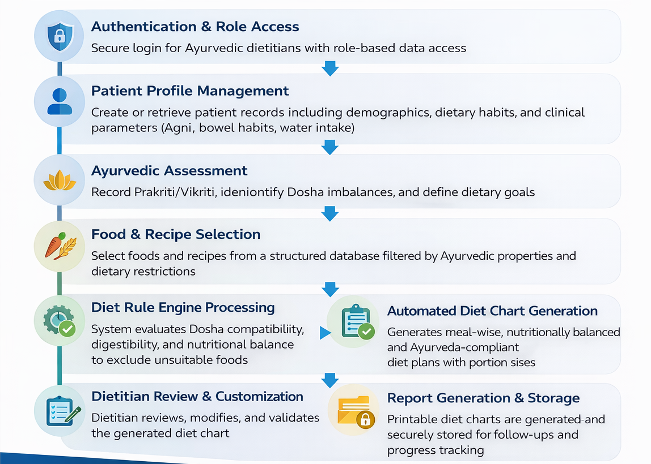
Basic Flow of the Project

Slide 10
Innovation / Novel Contributions
Ayurveda-Centric Digital Diet Framework
Introduces a structured digital representation of Ayurvedic dietary principles (Rasa, Guna, Virya, Digestibility) integrated with modern nutritional science.
Rule-Based Ayurvedic Diet Recommendation Engine
Implements a transparent, explainable rule engine that generates diet charts based on Dosha balance, Agni status, and clinical conditions—avoiding black-box automation.
Integrated Nutrient + Ayurvedic Food Database
Combines macro/micro-nutrient analysis with Ayurvedic food properties in a unified, extensible database suitable for Indian and multicultural diets.
Automated Yet Doctor-Controlled Diet Chart Generation
System automates meal-wise diet planning while preserving dietitian authority through manual review and customization.
Recipe-Level Nutrient & Ayurveda Analysis
Moves beyond food items to recipe-based diet charts, enabling realistic meal planning with accurate nutrient and Ayurvedic assessment.
Clinical Workflow-Aligned Design
Designed to mirror real Ayurvedic hospital workflows, reducing manual effort, improving consistency, and enabling scalable patient diet management.

Slide 11
Github Link
https://github.com/prjawal21/cloud-based-ayurvedic-diet-system

Slide 12
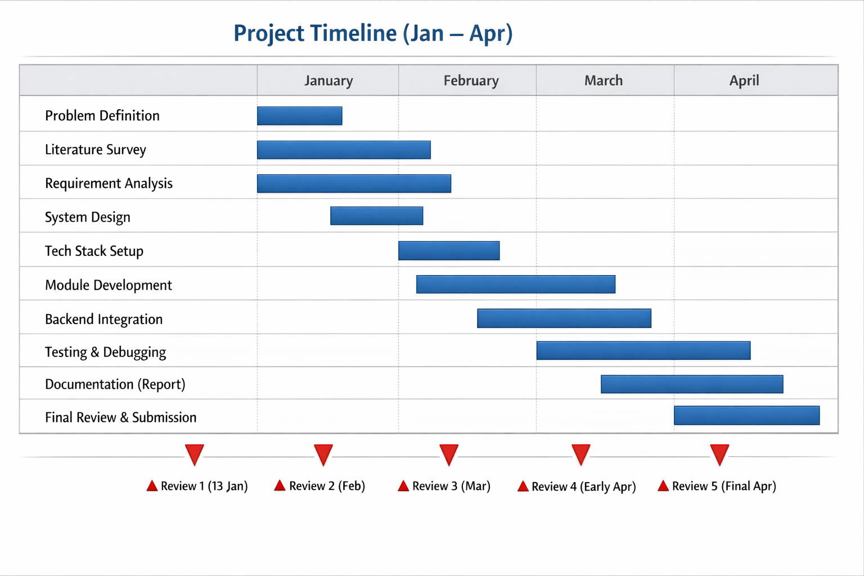
Timeline of the Project (Gantt Chart)

Slide 13
References (IEEE Paper format)
1. Wedaduru Disease Screening System
Title: "Wedaduru - An Intelligent Ayurvedic Disease Screening and Diet Recommendation System" Citation: Y. Amarasekara et al., 2020 IEEE International Conference on, DOI: 10.1109/ICAC49085.2020.9103410
2. AI Methodology for Ayurveda
Title: "Methodology for Development of Artificial Intelligence Models in Ayurveda" Citation: S. Yenishetti et al., 2024 IEEE 9th International Conference for Convergence in Technology (I2CT), DOI: 10.1109/I2CT61223.2024.10543901
3. Ayurvedic Herbs Prediction
Title: "Prediction of Ayurvedic Herbs for Specific Diseases by Classification Technique" Citation: P. Indoriya et al., 2022 IEEE Conference, DOI: 10.1109/...(9908981)
4. Ayurvedic Medicine Predictor Software
Title: "Software for Finding Ayurvedic Medicines for Diseases and Symptoms" Citation: IEEE Conference Proceedings, 2024, DOI: 10.1109/...(11071063)
5. AI-Driven Ayurvedic Personalization
Title: "Heart Disease Diagnosis and Diet Recommendation System Using Ayurvedic Principles" Citation: EAI/IEEE Endorsed Transactions (IEEE format), 2024, DOI: ...(6016)

Slide 14


